Slide 1
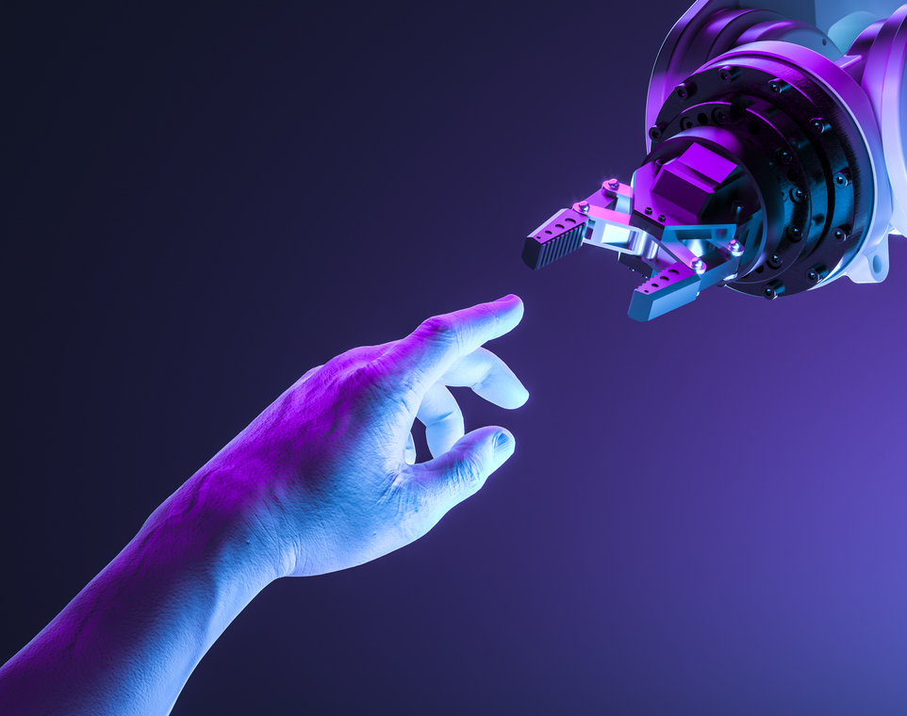
Artificial intelligence & Deep learning
Deep learning is a subset of machine learning where artificial neural networks, algorithms inspired by the human brain, learn from large amounts of data. ... Deep learning allows machines to solve complex problems even when using a data set that is very diverse, unstructured and inter-connected.

Slide 2
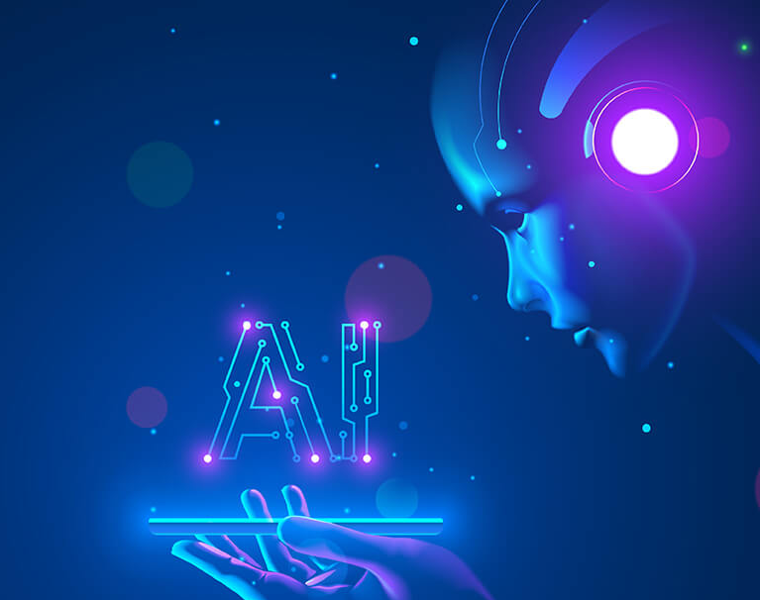
The Importance Of Deep Learning & AI
The ability to process large numbers of features makes deep learning very powerful when dealing with unstructured data.
AI allows organizations to make better decisions, improving core business processes by increasing both the speed and accuracy of strategic decision-making processes.
Feature Generation Automation
Works Well With Unstructured Data
Better Self-Learning Capabilities
Supports Parallel and Distributed Algorithms
Cost Effectiveness

Slide 3

Can AI & Deep Learning Solve Problems?
Deep learning adapts to the changes. It analyses problems in its hidden layers that are otherwise computationally difficult to solve. It reduces the task of generating new feature extractors for every data.
AI can be applied to cybersecurity For instance, AI prediction technology can be used to study millions of files and attacks to understand what exactly makes them up. By comprehending mathematical DNA, companies can prevent future attacks.
Artificial intelligence is being used to solve complex problems such as early detection of the pandemic, rapid case diagnosis, follow-up of treatments or detection of new cases with thermal cameras.

